Slide 1


Computer Vision: Seeing the World Through AI
Unlocking Insights, Transforming Industries
by Sanu K Joseph
Notes:
1

Slide 2
What is Computer Vision?
Seeing the World
Understanding Images
Empowering machines to perceive and understand visual information like humans do.
Interpreting the content of images and videos, recognizing objects, scenes, and patterns.
Notes:
2

Slide 3

How Computer Vision Works: The Pipeline
Image Acquisition
Capturing the image or video data
Preprocessing
Cleaning and preparing the data for analysis
Feature Extraction
Identifying key features within the image
Classification & Recognition
Categorizing and recognizing objects and patterns
Notes:
3

Slide 4



Role of AI & Machine Learning
Deep Learning
Machine Learning
AI algorithms trained on massive datasets to learn visual patterns
AI algorithms that can learn from data and improve their accuracy over time
Notes:
4

Slide 5

Rapid Growth & Accuracy Advancements
1
2010
Early deep learning models emerge
2
2015
Breakthroughs in image recognition accuracy
3
2020
AI surpasses human performance in many vision tasks
Notes:
5

Slide 6




History & Evolution
1950s
Early research on pattern recognition
1980s
Development of AI vision systems for specific tasks
2000s
Advancements in deep learning revolutionize the field
Today
AI vision applications transforming various industries
Notes:
6

Slide 7

Key Applications of Computer Vision
Healthcare
Medical image analysis, disease diagnosis
Retail
Product recognition, customer behavior analysis
Security
Facial recognition, surveillance systems
Automotive
Self-driving cars, advanced driver-assistance systems
Notes:
7

Slide 8
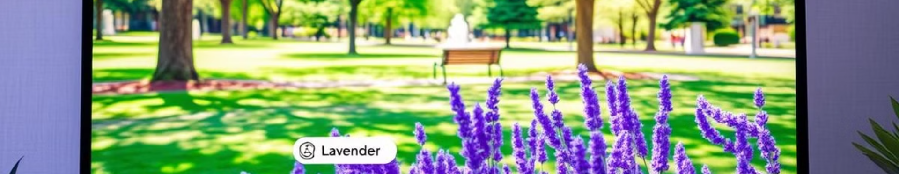
Core Tasks in Computer Vision
1
Object Recognition
2
Image Segmentation
Identifying and classifying objects within images
Dividing an image into different regions or segments
3
Optical Character Recognition (OCR)
4
Motion Detection
Extracting text from images
Tracking movement and identifying changes in a scene
Notes:
8

Slide 9
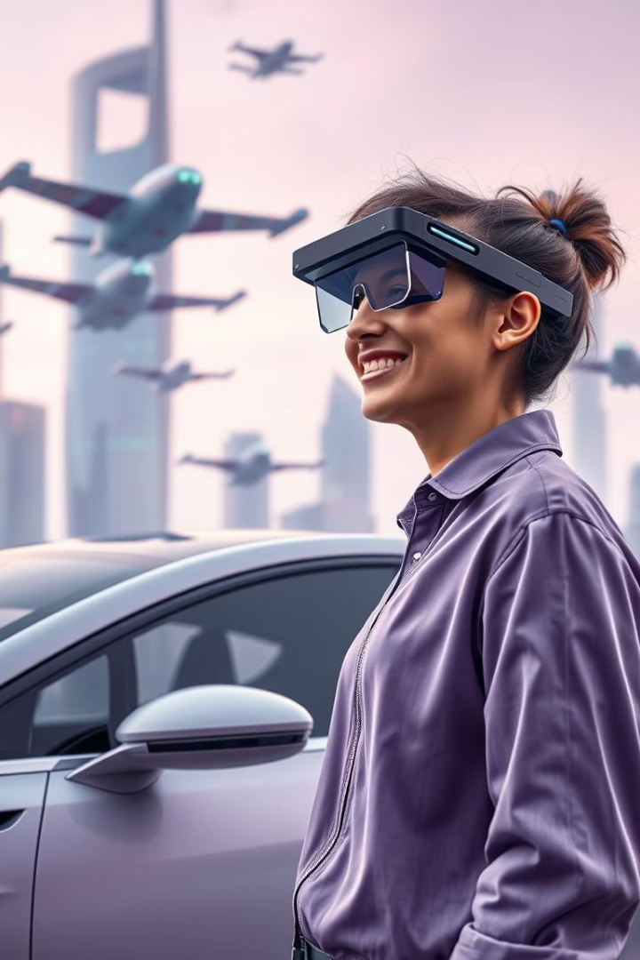

The Future of Computer Vision
1
2
Augmented Reality (AR)
Autonomous Vehicles
AI-powered visual experiences in real-time
Self-driving cars using AI vision for navigation
3
Robotics
Robots equipped with AI vision for complex tasks
Notes:
9

Slide 10
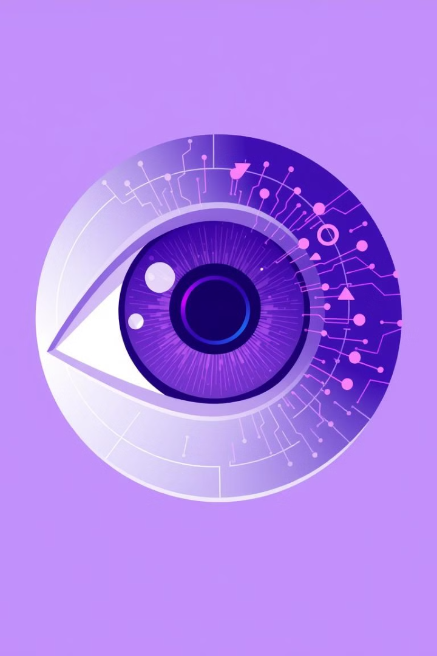
The Vision of AI is Here
Endless Possibilities Await
Notes:
10

